Slide 1
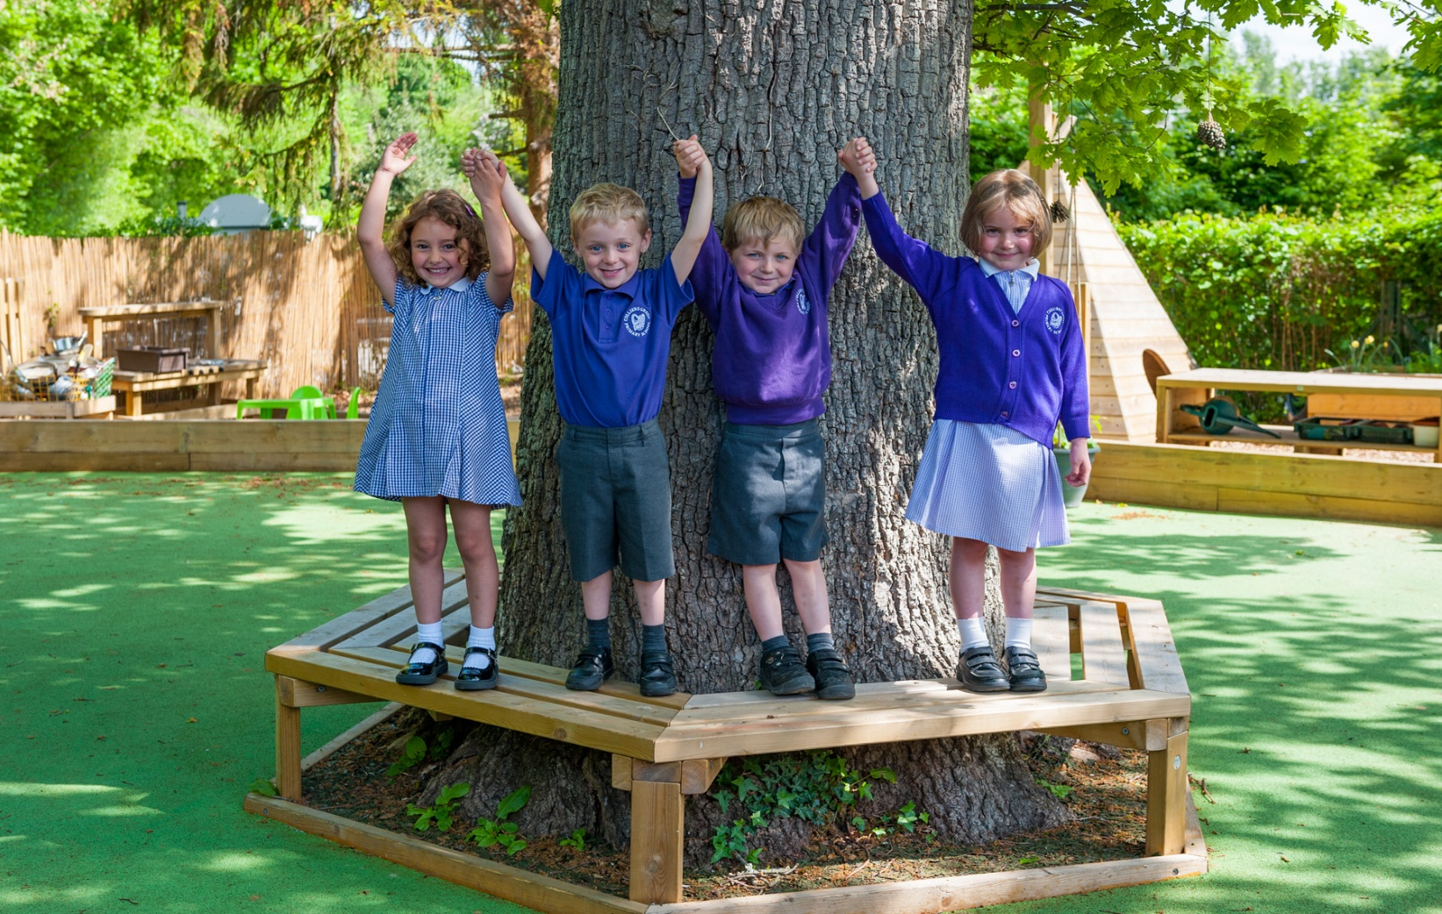

Welcome

Slide 2
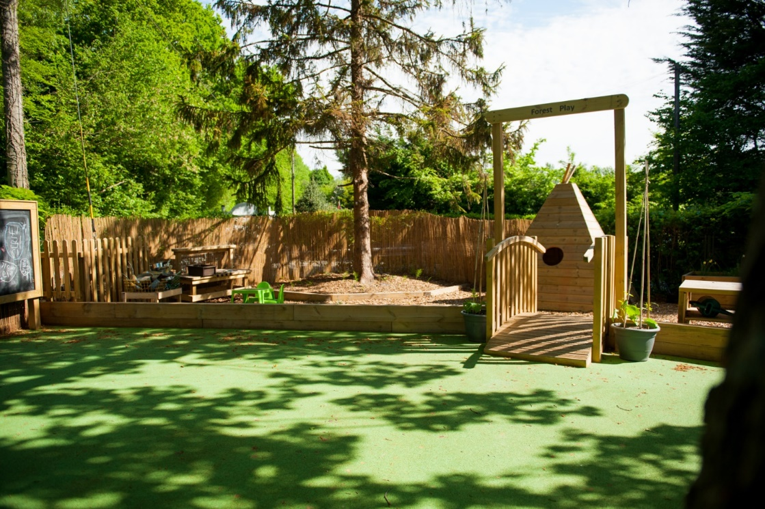
Why Colliers Green Primary School?
Church of England (voluntary aided) primary school.
Small, rural setting.
Family-feel, close knit community.

Slide 3
Setting
Modern, state of the art classrooms, completed in 2019.
New Early Years play area, completed October 2021.
Multi-surface playground.
Orchard, pond and wild classroom.
Beautiful grounds.
Forest school provision.

Slide 4

Vision
Colliers Green is a family.
We are a small rural school set in beautiful surroundings, where everyone feels welcomed and valued. We provide a caring, supportive and calm learning environment, rooted in our Christian values of aspiration, resilience and community. We encourage and nurture our children to flourish, and grow into their potential and achieve academic success, becoming compassionate individuals and valued citizens of God's world.

Slide 5

Values

Slide 6
Organisation
PAN of 16 pupils
113 pupils
4 classes
  Year R
  Year 1 + 2
  Year 3 + 4
  Year 5 + 6

Slide 7
Staff
Headteacher – Dr Hopkins
Class 1 Teacher – Miss Evans
Class 2 Teacher – Miss Armstrong
Class 3 Teacher – Ms Rahat
Class 4 Teacher – Miss Potts
SENCO – Miss Armstrong
Family Liaison Officer – Mrs Salter
Forest School – Mrs Barstow
Admissions – Mrs Addis

Slide 8
Performance
‘Good’ Ofsted report (June 2024)
Children come first at this small, welcoming school. ... Pupils feel safe here. They describe their school as a kind place.
... children benefit from a vibrant learning environment.
Staff enjoy working here. They take a child- centred approach in all they do, which is appreciated by parents and recognised by professionals from outside of school.
‘Good’ SIAMS report – (July 2018)
“The inclusive nature of the school values all pupils and their families in a warm, safe and welcoming Christian environment.”

Slide 9
EYFS and KS1 data
At the end of reception year, 71% made a ‘good level of development’.
In Year 1, 88% of children passed the phonics check.

Slide 10
Key Stage 2 data
Expected standard+ | Reading | Writing | Maths | RWM Combined
Colliers Green | 81% | 88% | 88% | 75%
National | 75% | 72% | 74% | 62%
Greater Depth | Reading | Writing | Maths | RWM Combined
Colliers Green | 38% | 19% | 25% | 6%
National (2024) | 28% | 13% | 24%

Slide 11
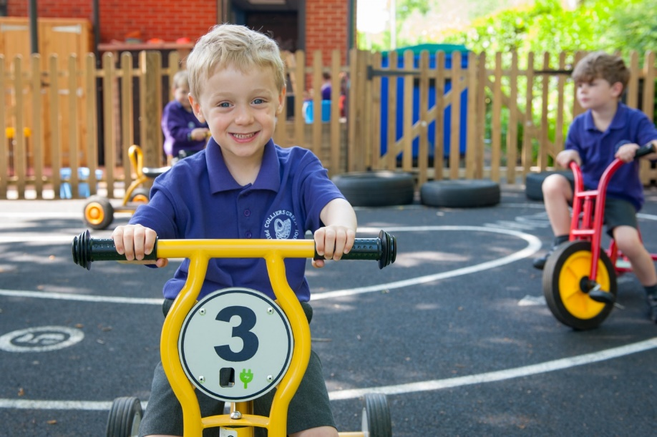
Transition to Colliers Green
Parent and child transition sessions
Nursery visits
Story sessions
Buddies with Y6 children

Slide 12
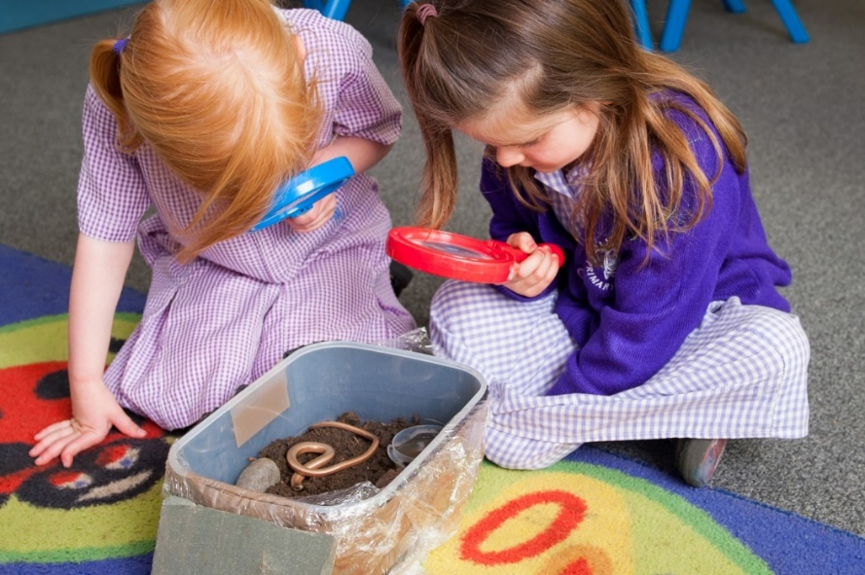
Starting school
Part time
Full time
Home visits in summer term
Baseline within first six weeks

Slide 13
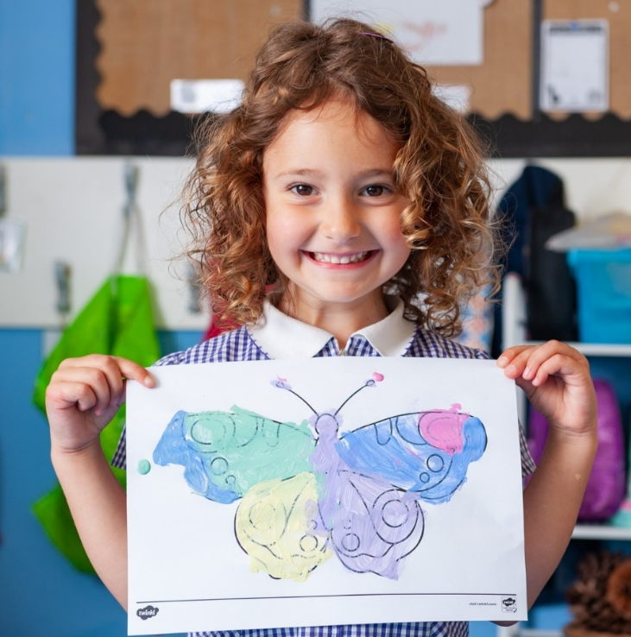
Early Years Foundation Stage
Prime Areas of Learning - Personal, Social and Emotional Development, Communication and Language, Physical Development
Specific Areas of Learning - literacy, maths, understanding the world, expressive arts and design.
Teacher Directed Learning and Child Initiated Learning

Slide 14
Wraparound care and clubs
Breakfast club from 7:45 every day - £4.00 a session.
Clubs held after school until 4:30. Most are £12.50 a term
  Gymnastics, football, hockey, dodgeball, cricket, art club, running, dance
Wraparound care is available until 6pm
  15:30 - 18:00 : £10.00
  15:30 - 17:00 : £8.00
  16:30 - 18:00 : £8.00
Choir meet at lunchtime
Rock Steady – band-based music lessons
Piano teacher

Slide 15
School lunches
Provided by Cranbrook Grammar school
£2.60 per day, but UIFSM in place until Year 3.
Invoiced termly directly by Cranbrook
Staggered sessions in hall

Slide 16
Applying for a place
Admissions opens on 7th November and closes on 15th January 2026 for a September 2026 start.
Apply online at kent.gov.uk
Name up to 3 schools, putting them in order of preference.
Schools will not know whether you have placed them first, second or third, they will just rank you against their subscription criteria.
Naming only 1 school does not guarantee a place at that school or give priority.
16th April 2026 results received by parents
Accept or decline by 30th April 2026

Slide 17
Admissions criteria
Children in local authority care
Children with siblings
Children for whom CG is nearest school
Children who live in the parish of St Dunstan’s who worship at St Dunstan’s, Cranbrook (SIF)
Children who live in the parish of St Dunstan’s who attend another Christian church (SIF).
Children living in the parish of St Dunstan’s (a map is available to view in the office)
Children living outside the parish of St Dunstan’s who attend another Christian church (SIF).
Children of school staff
All other children.

Slide 18
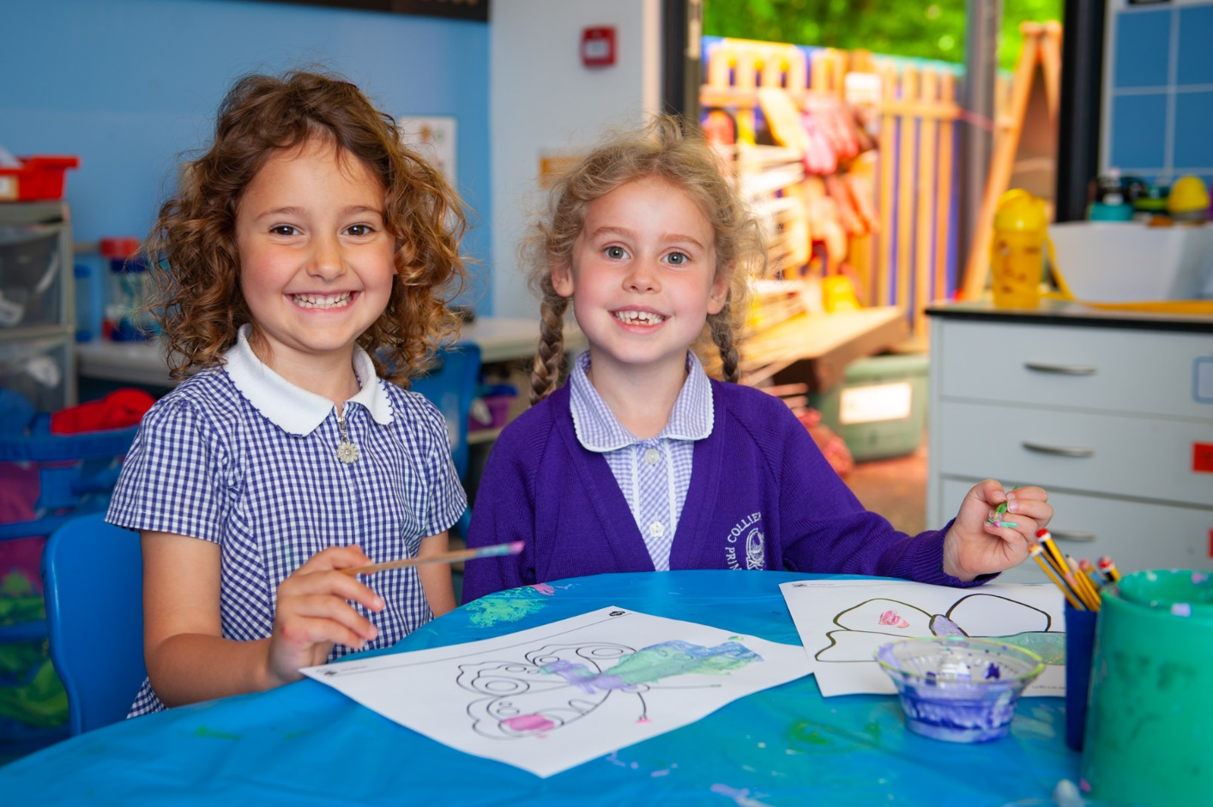
Any questions?
How do mixed-age classes work?

